Slide 1

Advances in quantitative genetics
Firza RIANY, Data Analyst
Email: firzariany2@gmail.com
Notes:
Hi, sebelum memulai praktikum hari ini, saya ingin memperkenalkan diri terlebih dahulu
Saya Firza. Saya lulus dari prodi Silvikultur tahun 2017, kemudian saya kerja di DRI bareng Mbak Fifi dan Pak Iskandar
Kemudian tahun 2018 pindah ke Finlandia untuk studi master di prodi European Forestry
Meskipun saya kuliah kehutanan, fokus saya lebih condong ke data analysis, jadi saya mulai belajar R dan programming di tahun 2018
Saya magang selama 6 bulan sebagai data analyst di institusi penelitian European Forest Institute, kemudian saya pindah ke Prancis tahun 2019
Di Prancis saya kuliah di Engineering School, jadilah lebih focus di data analysis
Lalu saya magang untuk menyelesaikan thesis saya, saya fully scripted Analisa saya di R, belajar machine learning dan sebagainya sampai akhirnya saya diterima bekerja di Climate Analytics di Berlin sebagai data analyst. Sekarang saya kadang2 pakai R, kadang2 python, dan punya basics di programming language lainnya.
Anyway, saya tetap kerja dengan data2 kehutanan seperti deforestation, climate change dll jadi saya bukan sepenuhnya lepas dari kehutanan.
So, hari ini saya akan memberikan kuliah tentang inovasi baru di quantitative genetics dan implementasinya, dan tutorial R. Saya harap materinya tidak terlalu sulit untuk dipahami.

Slide 2
Outline
Classical vs modern plant breeding.
Marker-assisted selection: GWAS, QTL, working pipeline
The concept behind GWAS and QTL Studies
Bias correction
Corporating genetic x environment interaction (GxE) in association studies
Implementation of association studies: Genetic control of resistance in black poplar (Populus nigra)
What you need to understand
What drives the innovation in quantitative genetics?
What are the aims of GWAS and QTL studies?
How do we get from sequencing the genotypes to selecting the genotypes?
How does the association modeling work?
What are the factors that contribute to GWAS and QTL studies?

Slide 3
Climate change
Drought. Pest attack.
Etc…
Food insecurity (not enough accessible and nutritious foods) and social vulnerability
Introduction: Classical and modern plant breeding
Innovations:
Finding plants with high tolerance to droughts.
Finding plants that produce high yields even with low input
Plants that are resistant to pest attack
Using plant breeding method
Plant breeding: a method to produce a line or a plant with desired characteristics
Research on the genetics that control these traits so that these traits can be passed on to the next generation.

Slide 4
Introduction: Classical and modern plant breeding
Classical plant breeding
Modern plant breeding
Selection: Selectively propagating plants with desirable characteristics and eliminating the others
Crossing: Interbreeding of closely or distantly related individuals to create new crop varieties with desirable characteristics.
Introduce individuals with different levels of variation in the trait of interest (hence different genes) to create a new variety that ensures its desirability and genetic variation.
Inbreeding: Crossing plants with themselves
Marker-assisted selection: selecting individual lines with desirable characteristics based on the studies of the genetics of these characteristics.
Quantitative Trait Loci Studies (QTL Studies)
Genome-Wide Association Studies (GWAS)

Slide 5
Concept of complex traits, QTL Studies, and GWAS
QTL (Quantitative Trait Loci)
Relates the genotype and a phenotype using statistical method to find the region in the genome where the association happens for individuals created from experimental crossings.
GWAS (Genome-Wide Association Studies)
Relates the genotype and a phenotype using statistical method to find the region in the genome where the association happens for unrelated individuals coming from different populations. The study is done for the whole genome.
Yield, diameter, height, resistance are the examples of complex traits
Complex traits: traits that are controlled by many genes (polygenic)
Genes can be majorly contributed to a trait (or phenotype) or can be minorly
Across the genome of an individual, there are many genes that can control a complex trait
We can scan through the whole genome and model the genes that are associating with the trait in question.
A very simplistic definition. In practice, they can go together. You can find QTL when you use GWAS. Or you can first find QTL to find the region then use GWAS to confirm the region.

Slide 6
Marker-assisted selection: the working pipeline
Mapping population
Data collection
Data analysis
Found the genome regions where association happens
From crossing or natural populations
Measurement of the phenotype in question
Genotype sequencing (using SNPs)
Statistical modeling to find the association between genotype and phenotype
(i.e. with linear regression or mixed linear model)
Candidate genes
Selecting individuals that have the candidate genes
Detect the genes in those regions. Evaluate them in BLAST
These candidate genes are subject to selection

Slide 7
Mapping population and data collection
Mapping population is composed by individuals whose phenotypes and genotypes are to be measured
We collect phenotype data, for example height, from these individuals
We also sequence their genotype (using Single Nucleotide Polymorphism)
Other information we may need: environmental condition in the mapping population (i.e. temperature, soil condition, precipitation, longitude, latitude)
Two types of mapping population:
Population with individuals created from experimental crossing
Population with individuals that are coming from natural populations

Slide 8
Mapping population
Experimental crossing
Individuals are created by crossing distantly or closely related parents
Example: crossing Populus deltoides (North America) and Populus trichocarpa (Western America) to create a hybrid P x interamericana with resistance
Natural population
Individuals are created by sampling them from natural populations
Example: collecting samples of Populus nigra from their natural population. Samples are taken to the lab for genotyping. Phenotypes are measured in the field. Or samples can be grown in the laboratory for other measurements.

Slide 9
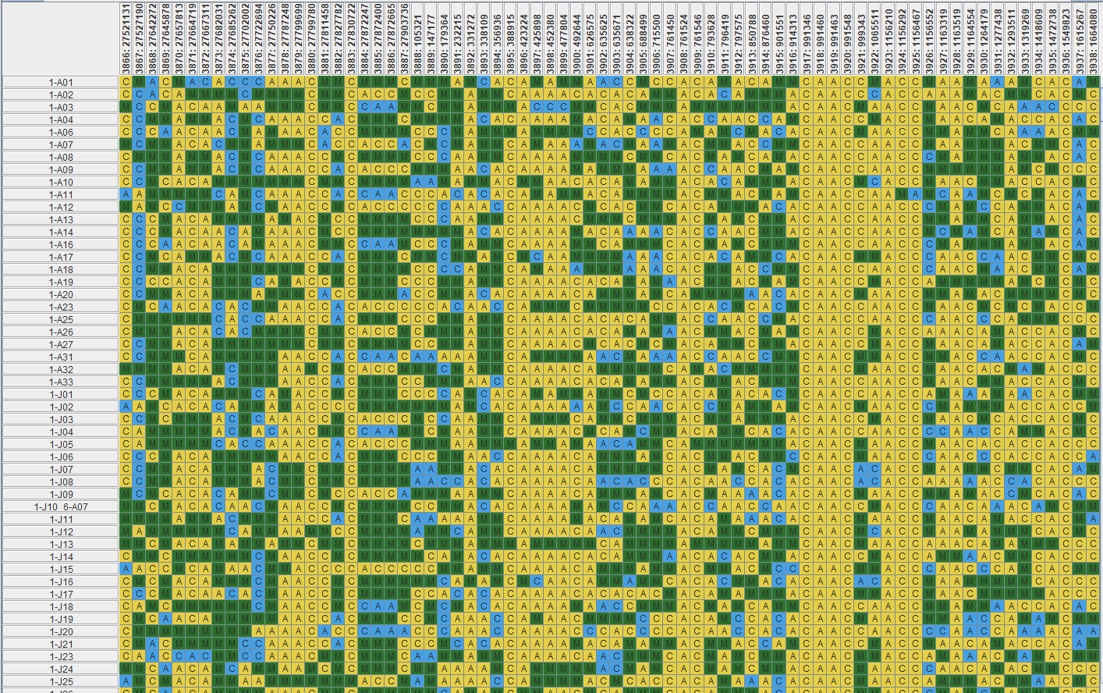
Data collection
Location of the SNP in the genome
Phenotypic data: collected from measurement
Genotypic data: collected from sequencing using Single Nucleotide Polymorphism
Coding the nucleotide base at a specific position in a genome
Example of the genotype data:
Individuals
Genetic code
Notes:
For example, at a specific base position in the human genome, the C nucleotide may appear in most individuals, but in a minority of individuals, the position is occupied by an A. This means that there is a SNP at this specific position, and the two possible nucleotide variations – C or A – are said to be the alleles for this specific position.

Slide 10
Data analysis: The concept behind GWAS and QTL Studies?
The modeling
Aim of GWAS: find the association between phenotype and genotype
Intuition:
Take the genes that most frequently appear across individuals when we measure the phenotype in question
How the genes are related to the phenotype
And where are these gene located in an individual’s genome
For example:
There are 10 individuals
Genes are coded with C and A
SNPs are used to code the genes in 3 locations in the genome
Height is the phenotype being measured
Model the association: what genes that most frequently appear when the individuals are tall? Where in the genome?
Ind. | SNP_1 | SNP_2 | SNP_3 | Height
1 | C | A | A | 12
2 | C | C | A | 15
3 | A | C | C | 10
4 | C | C | A | 10.5
5 | C | C | C | 15
6 | A | C | A | 9
7 | C | C | A | 9.5
8 | C | C | A | 9
9 | C | C | A | 9.5
10 | A | A | A | 8

Slide 11
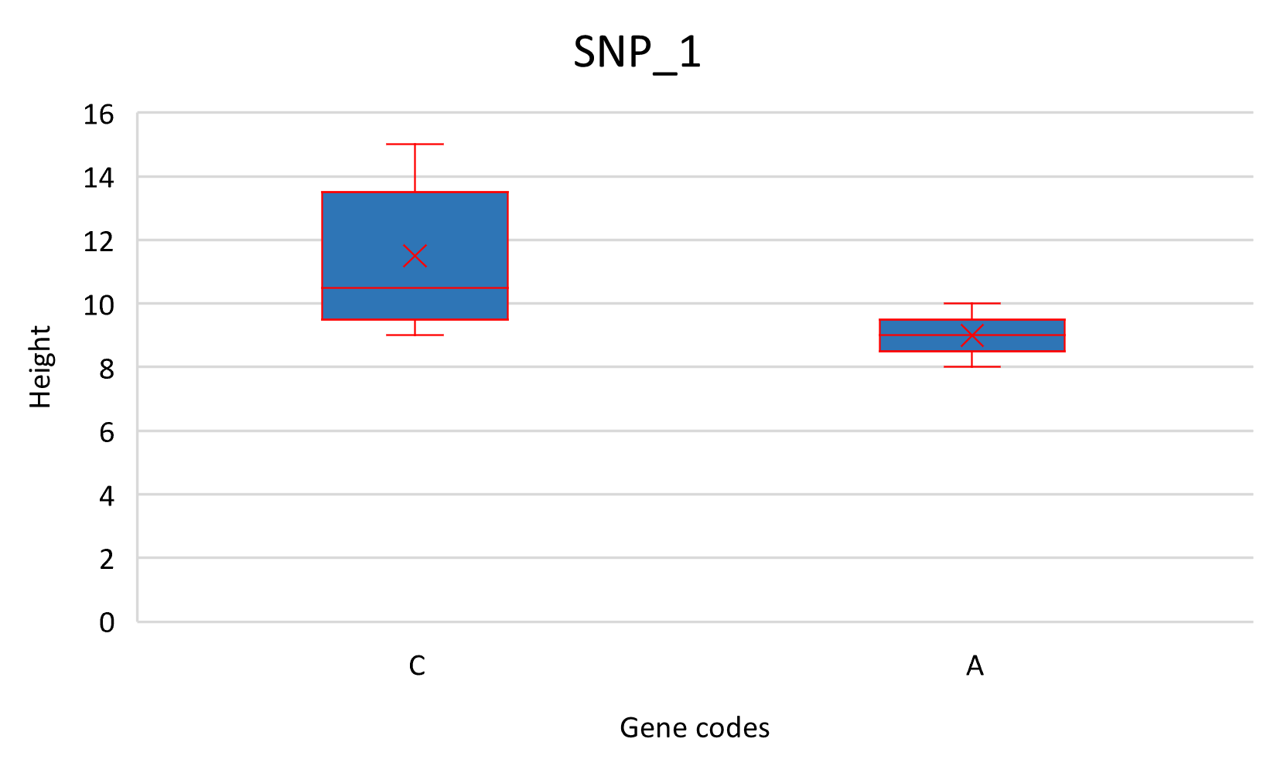
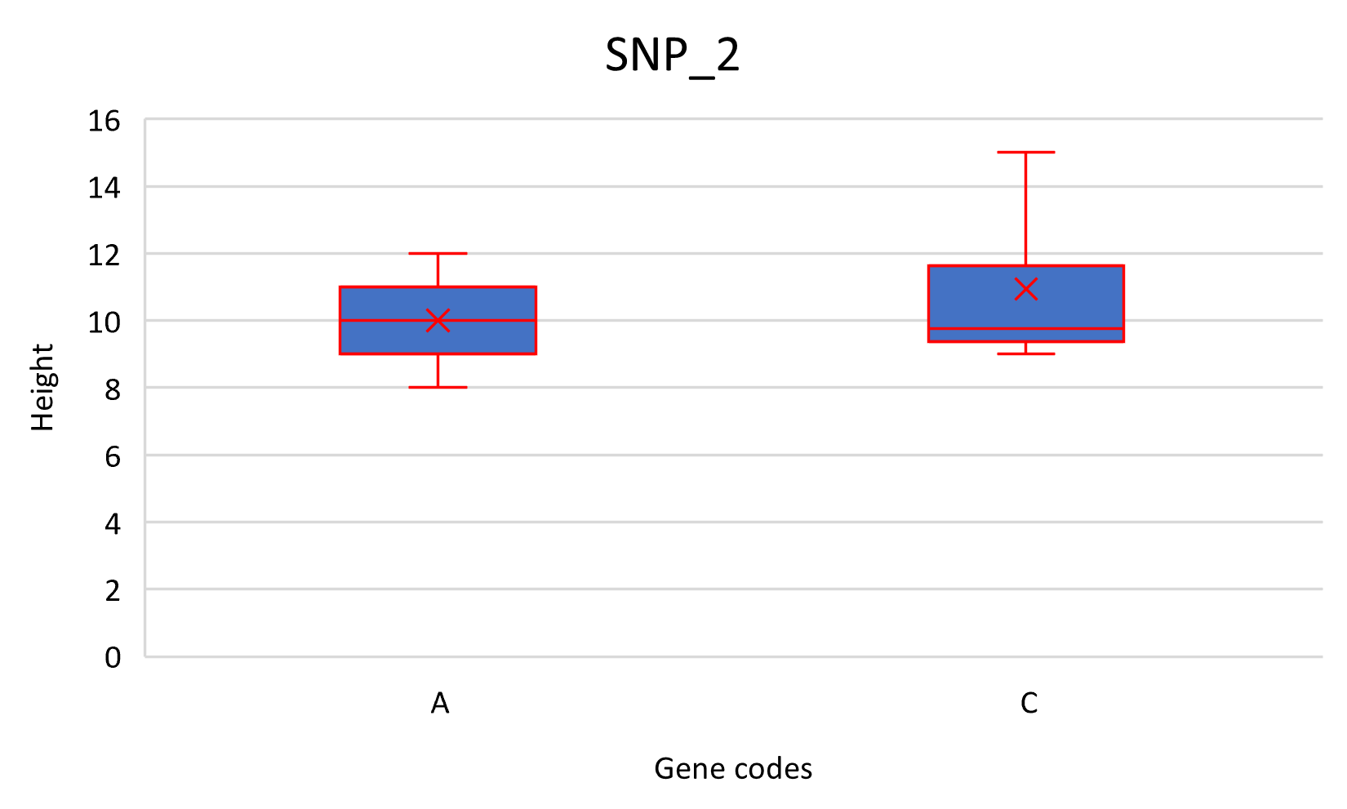
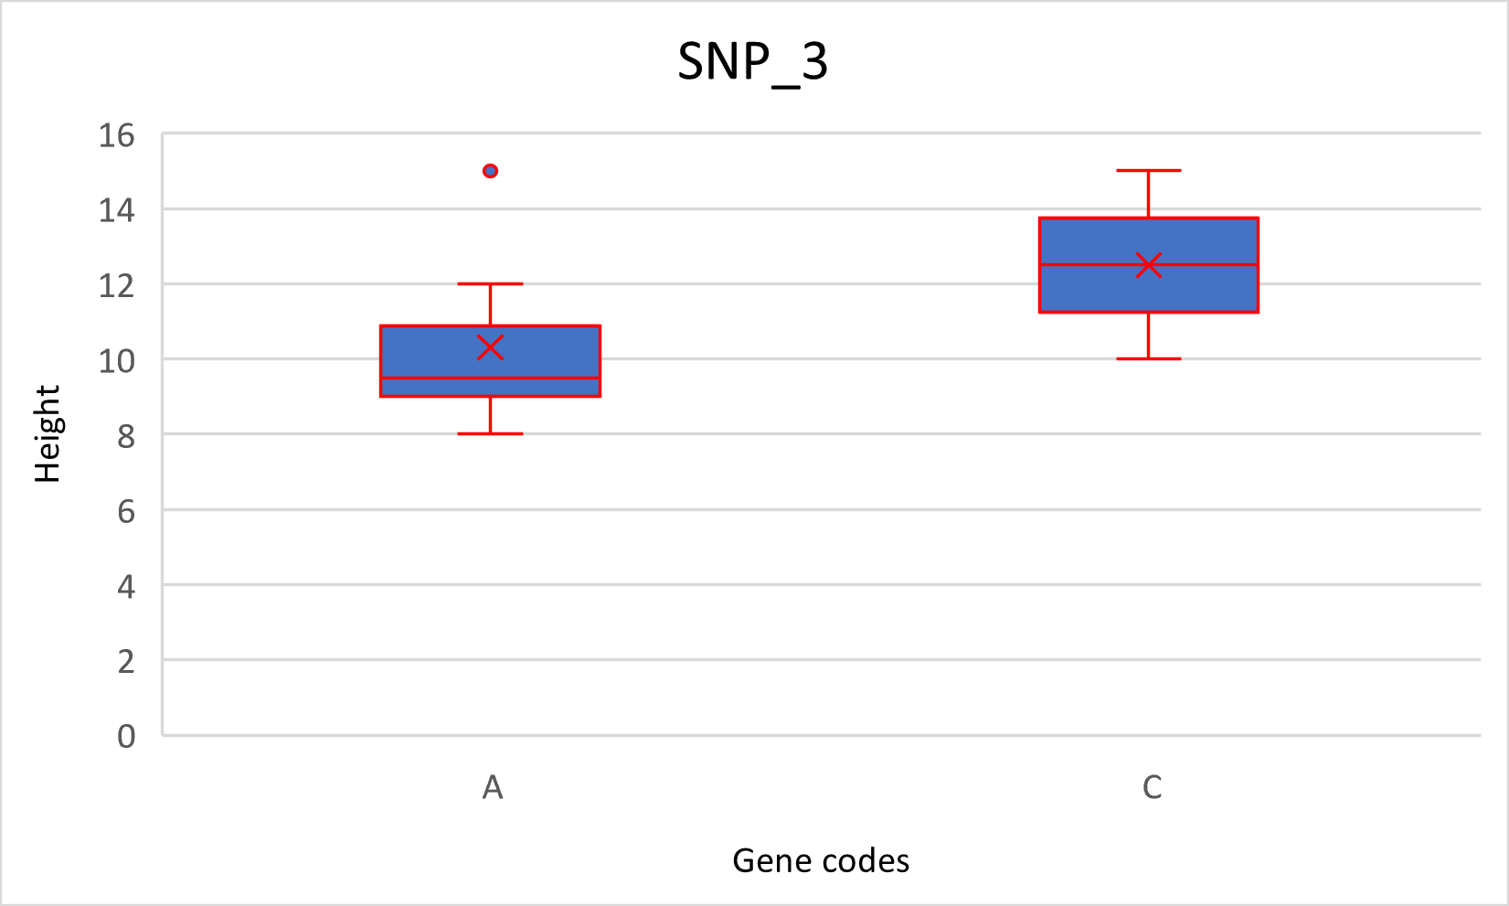
Data analysis: The concept behind GWAS and QTL Studies?
The modeling
Ind. | SNP_1 | SNP_2 | SNP_3 | Height
1 | C | A | A | 12
2 | C | C | A | 15
3 | A | C | C | 10
4 | C | C | A | 10.5
5 | C | C | C | 15
6 | A | C | A | 9
7 | C | C | A | 9.5
8 | C | C | A | 9
9 | C | C | A | 9.5
10 | A | A | A | 8
Individuals with gene C are taller than individuals with gene A in SNP_1 and SNP_3
Meaning that gene C is likely to be associated with tall height.
And it happens if gene C appears in location 1 and 3 of the individual’s genome.
To check if the heights are significantly different between gene A and C, we should check it with p-value generated by linear regression or mixed linear model
Notes:
P-value that basically says that the results from gene A and C are two different results

Slide 12
Data analysis: The concept behind GWAS and QTL Studies?
To have a reliable result, we need more than 10 individuals and 3 SNPs
In practice, you can have 400 individuals with 10.000 SNPs, or more, depending on the type of your population (natural or crossing) and the goal of the study.
This is because the result of association depends on the repetition of the gene across individuals and across location in the genome.
In my thesis, I studied the genetics of resistance in black poplars. I had 150 individuals and 7800 SNPs. It was not quite enough, in the further research the team added another 150 individuals to improve the statistical power.

Slide 13
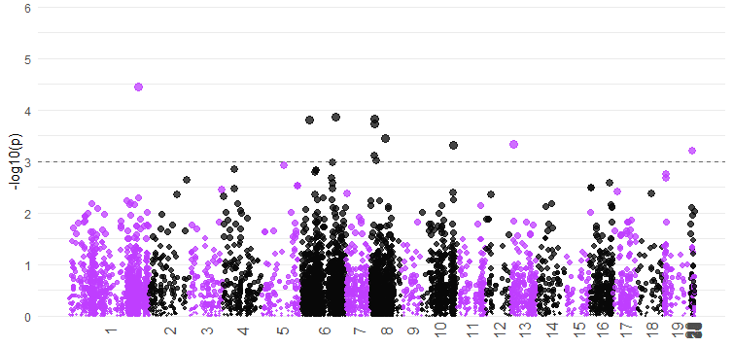
Data analysis: Manhattan plot
So, what happens if we have 10k SNPs and a lot of individuals?
We can’t evaluate the effect of the genes in each location. We evaluate the p-value. The result would be visualized in a Manhattan plot:
Latent period P72
P-value
Chromosomes
Notes:
We want to see the fluctuations of the p-values of each model because it essentially tells us if the genes A and C yields to different results

Slide 14
Data analysis: Classification
How to determine the candidate genes?
Define a threshold.
Method: Bonferroni, Benjamini-Hochberg, or Holm procedures
A threshold differentiates which genes are significantly associated with the phenotype → they are called candidate genes
Latent period P72
QTL
QTL
Candidate genes
Threshold
P-value
Chromosomes
Notes:
We want to see the fluctuations of the p-values of each model because it essentially tells us if the genes A and C yields to different results

Slide 15
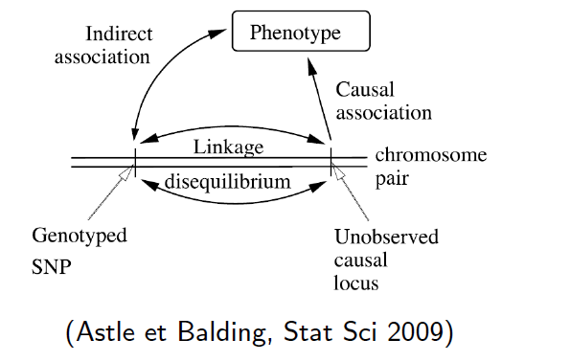
Data analysis: The concept behind GWAS and QTL Studies?
Linkage Disequilibrium
In GWAS and QTL studies, when we find an association, it does not necessarily mean we find a causal association between the genes and the phenotype
This is because we do not know if we have genotyped all the causal genes in the genome
Linkage disequilibrium: the imbalance in allele frequency; one allele may appear more than the other
Meaning that a certain allele appears most frequently when individuals show phenotypic variability to a certain degree.
These alleles will be shown repetitively on Manhattan plot in a consistent location.
Linkage disequilibrium between alleles can give us a greater chance to find the causal association
Latent period P72
Notes:
Linkage disequilibrium and SNP density are central to the reliability of GWAS result

Slide 16
Data analysis: The concept behind GWAS and QTL Studies?
SNP density
Besides linkage disequilibrium, SNP density is also central in GWAS → the more SNPs covering the whole genome, the better the chance to find the causal genes.
Notes:
Linkage disequilibrium and SNP density are central to the reliability of GWAS result

Slide 17
Data analysis: Bias correction
Phenotype variability can be due to relationship between individuals and geographical origins of the individuals
Individuals that are related to each other tend to have similar phenotype variability.
Individuals that are coming from the same geographical origins also tend to have similar phenotype variability.
We want to eliminate these factors because even though they contribute to association, they are not the factors we want to consider.
We want to consider the genetic control of this variability.
There is a correction method for these factors.

Slide 18
Corporating G x E interaction in GWAS and QTL
Complex traits are not only controlled by genotype but also by interaction between genotype and environment
Different environment → different genes that are associated with the phenotype
In GWAS, you can factor the environment effects by sampling individuals from many locations
It will allow you to get consistent candidate genes across different environments

Slide 19
Key takeways
Climate change poses challenges to natural and human systems, such as food insecurity and social vulnerability. Innovations in plant breeding are made to produce individuals that can adapt to these challenges.
GWAS and QTL studies are statistical methods to find the genome region where there is association between genotypes and phenotypes.
The methods evaluate the association at the gene level, one by one. The genes with significant association (evaluated using P-value) are called candidate genes.
The methods also identify the locations of these candidate genes in the individual’s genome.
The factors that contribute to GWAS results:
The number of sample individuals
The number and density of the SNPs
Linkage disequilibrium
Population structure
Relationship between individuals (relatives, siblings)
G x E interaction

Slide 20
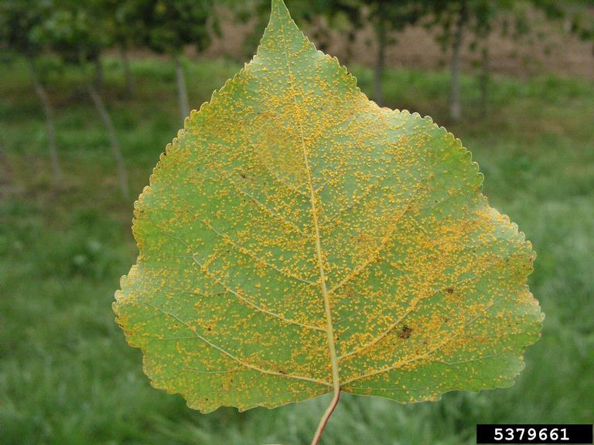
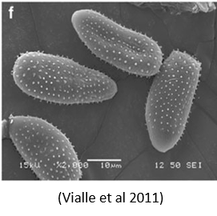
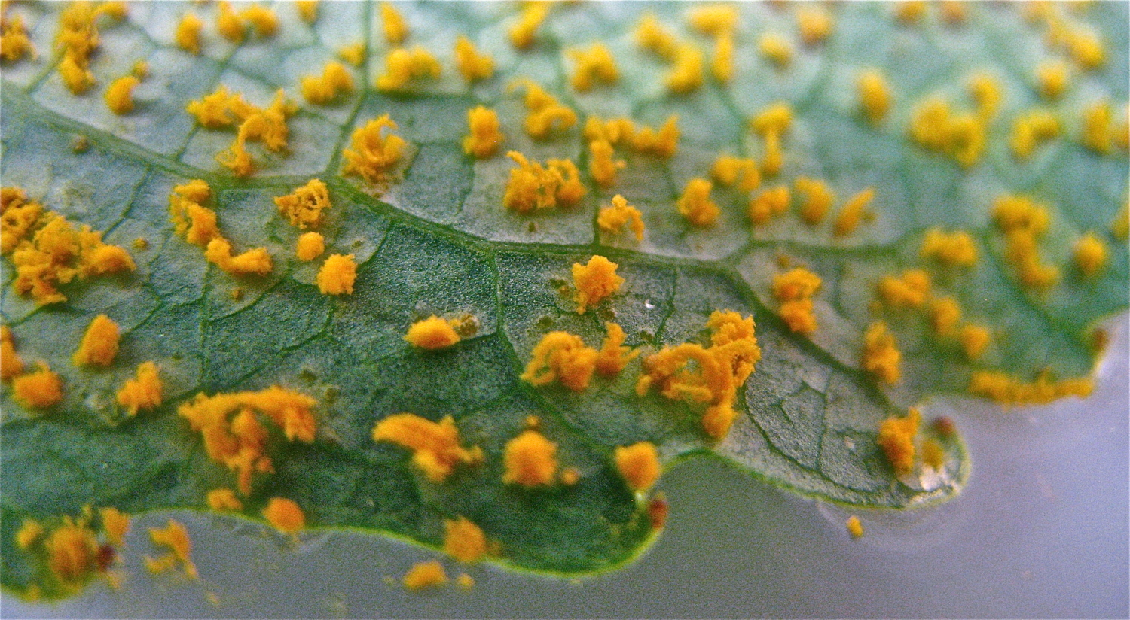
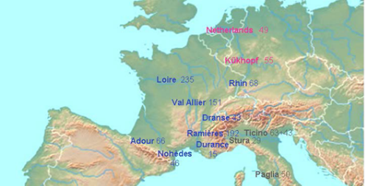
GWAS implementation
Topic: Genetic control of resistance in black poplar (Populus nigra)
Background: black poplar has been attacked by rust fungi → lead to economic losses
Aims of the study:
Observing the resistance in black poplar
Depicting the genetic control of resistance
Melampsora laricii-populina
(rust)
09AX27
Inoc. Press: 564 (40%)
Data collection
154 P. nigra genotypes collected from 12 natural populations in Western Europe
3 rust pathogens isolated from their populations
3 resistance components: latent period, uredinia number and uredinia size
Mostly are from France
Data measurements
Phenotype: samples are taken to the lab → inoculated with 3 pathogens → resistance components are measured in the lab
Genotype: Genomic sequencing with high-resolution SNPs. Total SNPs used were 7.800

Slide 21
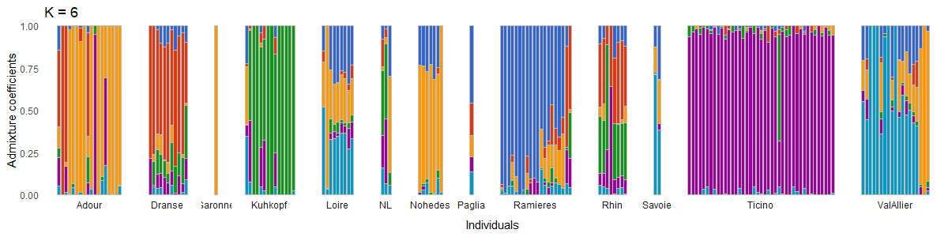
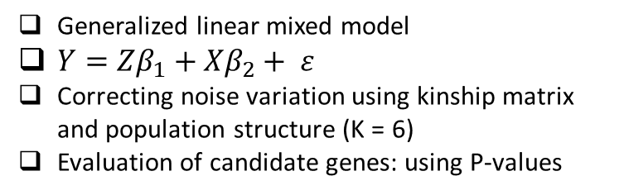
Analyses and Results
DEPICTING THE GENETICS OF RESISTANCE USING GWAS
The materials
The model
Genomic matrix: 154 genotypes x 7 800 SNPs
Generalized linear mixed model
$Y=Zβ_{1}+Xβ_{2}+ ε$
Correcting noise variation using kinship matrix and population structure (K = 6)
Evaluation of candidate genes: using P-values
Population structure chart. Individuals tend to group with the individuals that come from the same location

Slide 22
Analyses and Results
DEPICTING THE GENETICS OF RESISTANCE USING GWAS
The results
Latent period P72
- Triose-phosphate Transporter family
- Acetyltransferase (GNAT) family
- Glycosyl hydrolases family 16
P-value threshold: 0.001, -log10(0.001) = -3
Found 80 candidate genes in total for all the resistance components and rust pathogens
Serine Threonine Protein Kinase
YL1 nuclear family protein
Heavy-metal-associated domain
Flavonoid biosynthesis
Evaluate the candidate genes in BLAST
Serine threonine protein kinase: related to plant resistance
Leucine rich repeat (LRR) protein family: mediators for plant defence mechanism

Slide 23

Future Perspectives
THE IMPACTS OF THE STUDY FOR POPLAR’S BREEDING PROGRAM
Confirming the candidate genes for marker-assisted selection
Through further research on the genes’ regulation pathways and functions
Selecting a group of poplars with various resistance across the strains
A group of poplars with resistance and with various degree of interaction to reduce the possibility of inducing evolution in rust.
Improving GWAS
By testing more genotypes with more rust strains to increase the statistical power.
Confirming the genetic control of the resistance’s strain-specificity
To see if the specificity is genetically controlled or not by modeling the association between interaction parameters and SNPs

Slide 24

So, contact me! Send me an email: firzariany2@gmail.com Find me on LinkedIn: Firza Riany | LinkedIn Read my blog about data and environmental science: Firza Riany – Medium Check my projects: firzaariany (Firza Riany) (github.com)

